Slide 1

MOVIE RANK ANALYSIS
Presented by : Baladithya Veluduti
Batch No. : 546

Slide 2

About Me
  Name: Baladithya Veluduti
  Qualification : B. Tech(CSE)
  Institution: Anurag University
  Core Interests: I am interested in Data science because I enjoy to solve real world business problem using Data
  Career Objective: Motivated and detail-oriented aspiring Data Scientist with hands-on experience , data cleaning, exploratory data analysis and visualization using Python, pandas, Matplotlib and Seaborn. I can turn raw data into meaningful business insights and keep growing my skills in machine learning and analytics..
  Linked In: https://www.linkedin.com/in/baladithya-veluduti-556327287/7

Slide 3

Agenda
  Introduction
  Business Problem
  Problem Statement
  Data Collection
  Data Description
  Data Cleaning & Preprocessing
  Data Visualization & Insights
  Testing
  Conclusion
  Future Enhancements

Slide 4
Introduction
  TMDB is a community-built movie database. Its Top Rated page ranks movies by user score, and each movie has a detail page.
  Workflow followed: collect → describe → clean → test → visualize → answer business questions.
  Tools: Python, Selenium, BeautifulSoup, pandas, NumPy, Matplotlib, Seaborn, Jupyter Notebook.

Slide 5
Business Problem
  Studios, streaming platforms and marketers need to know what audiences rate highly before deciding what to produce, buy or promote.
  This information is spread across many web pages, and collecting it by hand is slow, inconsistent and doesn’t scale.
  They need a repeatable way to turn rated-movie data into answers about genre, decade, runtime, language, budget and director.
  A key question is whether spending more money leads to better-rated movies.

Slide 6
Problem Statement
  Scrape the Top Rated movie list from TMDB (themoviedb.org/movie/top-rated).
  Build a clean, structured dataset from it.
  Answer these questions:
    Which movies, decades, genres and directors dominate the list?
    What are the typical runtime, certificate and original language?
    Do longer movies get better ratings?
    Do bigger budgets get better ratings, and which movies earn the most revenue and profit?
  Make the whole project reproducible by running the notebook from top to bottom.

Slide 7
Data Collection
  Source: the TMDB Top Rated list pages and each movie’s own page.
  Stage 1, list pages
  Read title, release date and link for every movie card.
  Remove duplicates using the movie link.
  Stage 2, movie pages
  Read genre, director, runtime, certificate, language, budget, revenue, user score and overview.

Slide 8

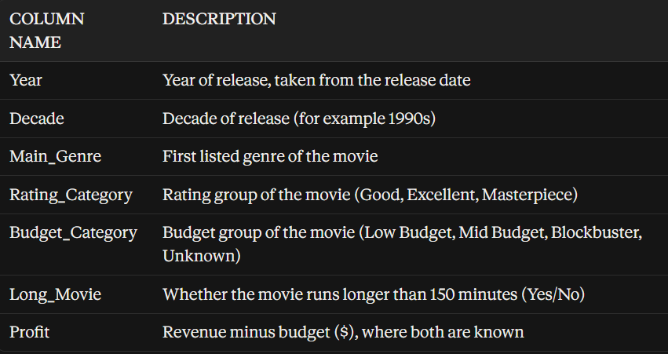

Data Description
The collected dataset contains 200 top rated movie records with 13 attributes describing each movie listed on TMDB (themoviedb.org).
Notes:
9

Slide 9
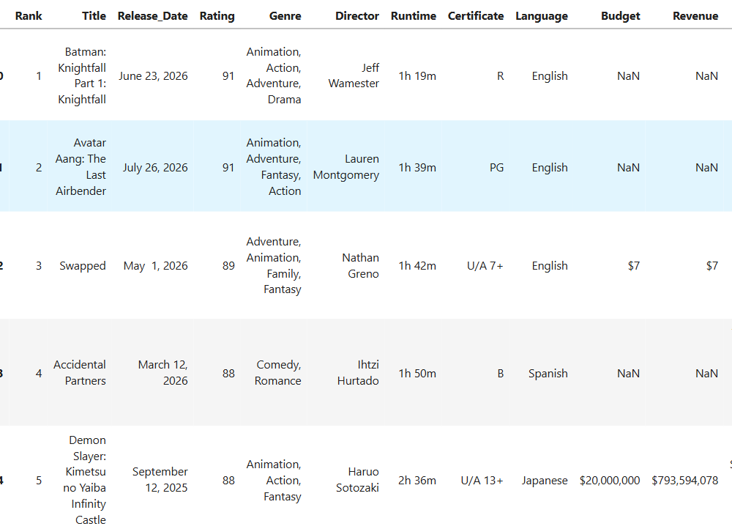
Sample of Dataset

Slide 10
Data Cleaning & Preprocessing
  Dropped rows without a title.
  Converted release dates to real dates, created Year and Decade, and filled missing years with the median.
  Converted the user score (a percentage like 87) to a rating out of 10 and filled missing ratings with the median.
  Converted runtime from “2h 22m” to minutes and filled missing values with the median.
  Converted budget and revenue from “$25,000,000.00” to integers, with 0 where TMDB shows no value.
  Filled missing certificates with “Not Rated” and missing language, genre and director with “Unknown”.
  Checked for duplicates and removed them.
  Created new features: Main_Genre, Rating_Category, Budget_Category, Long_Movie and Profit.
  Confirmed afterwards that there are no missing values, except Profit, which is intentionally empty where budget or revenue is unknown.

Slide 11
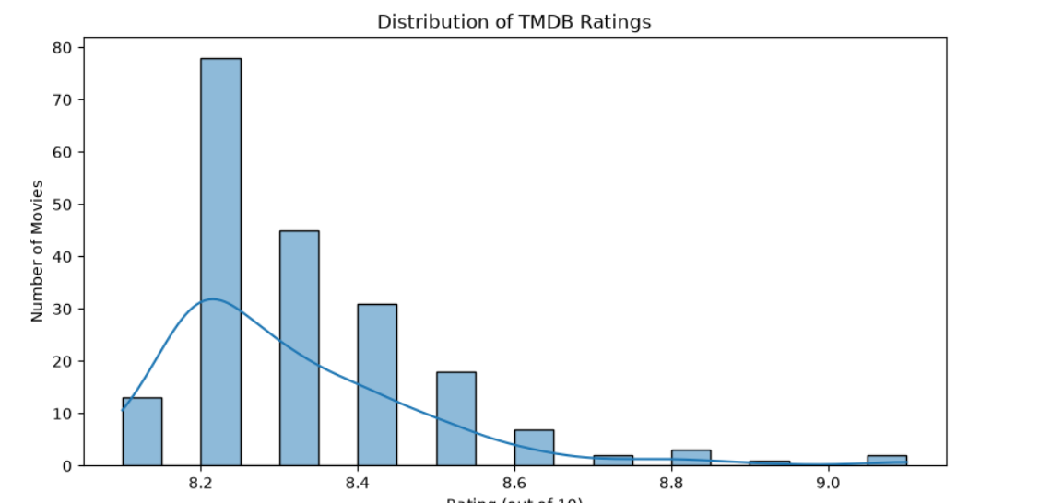
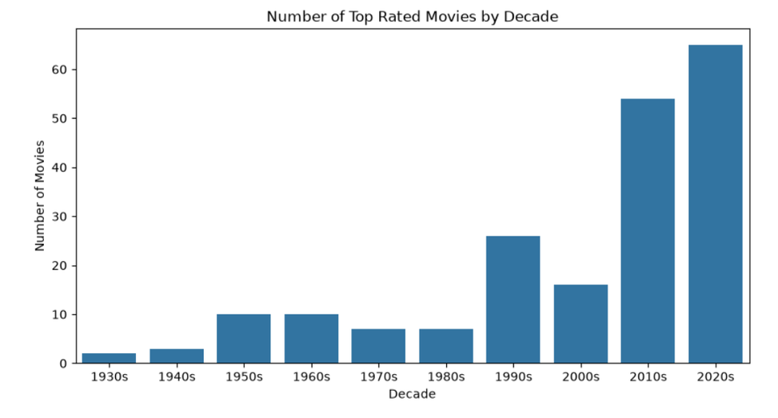
Data Visualization & Insights
Univariate Analysis
1. Rating Distribution
  Ratings range from about 8.1 to 9.1, a narrow high band because this is a top rated list.
  Most movies are between 8.2 and 8.4: about 78 at 8.2, 45 at 8.3 and 31 at 8.4, roughly 77% of all movies.
  The chart is right-skewed. Only about 15 movies (around 7%) score 8.6 or higher, and very few reach 9.0 and above.
2. Movies per Decade
  The 2020s have the most top rated movies (about 65), followed by the 2010s (about 54).
  These two decades together hold about 60% of the list.
  The 1990s (about 26) are the strongest older decade. The 1930s and 1940s have only 2 and 3 movies.
  This suggests the list is dominated by recent movies, partly because newer movies are rated by more users on TMDB.

Slide 12
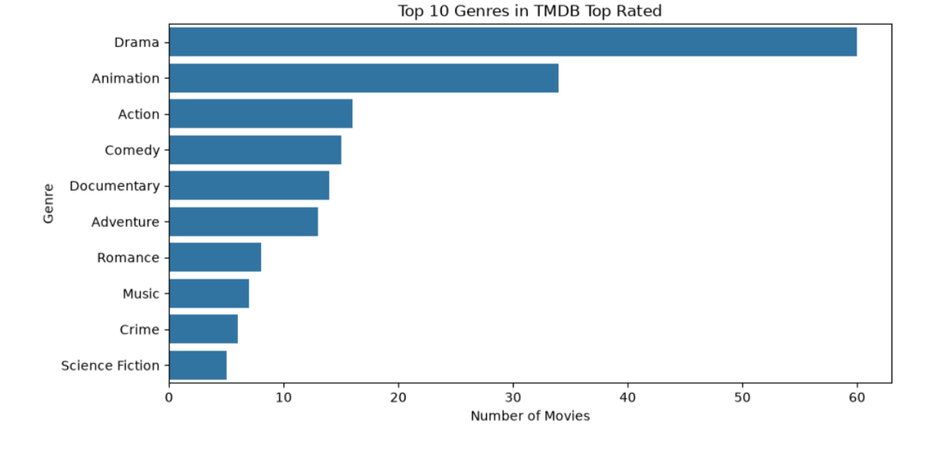
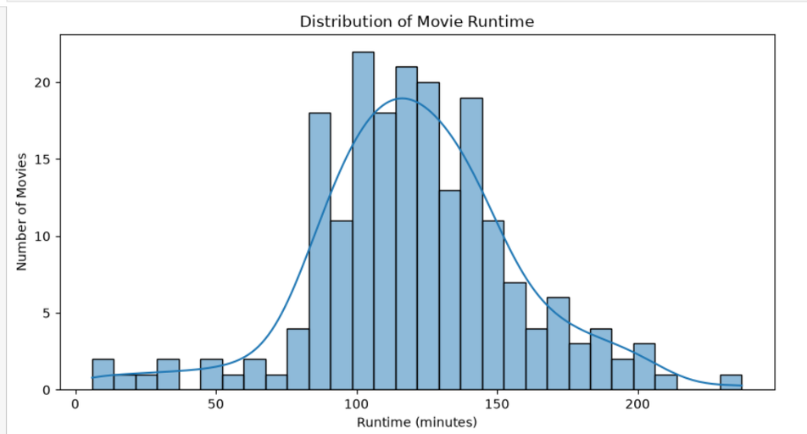
3. Top 10 Genres
  Drama is the clear leader with about 60 movies, around 30% of the list.
  Animation is second (about 34), so Drama and Animation together make up almost half the list.
  Action (about 16), Comedy (about 15), Documentary (about 14) and Adventure (about 13) follow closely together.
  Romance, Music, Crime and Science Fiction appear only 5 to 8 times each.
4. Runtime Distribution
  Most movies run between about 85 and 150 minutes, with the peak around 100 to 130 minutes.
  The distribution is slightly right-skewed. A few movies go beyond 180 minutes, with the longest at about 236 minutes.
  There is a small group of very short titles under 60 minutes (about 10 movies), as short films are included in the list.
  A typical top rated movie is feature length, around two hours.

Slide 13
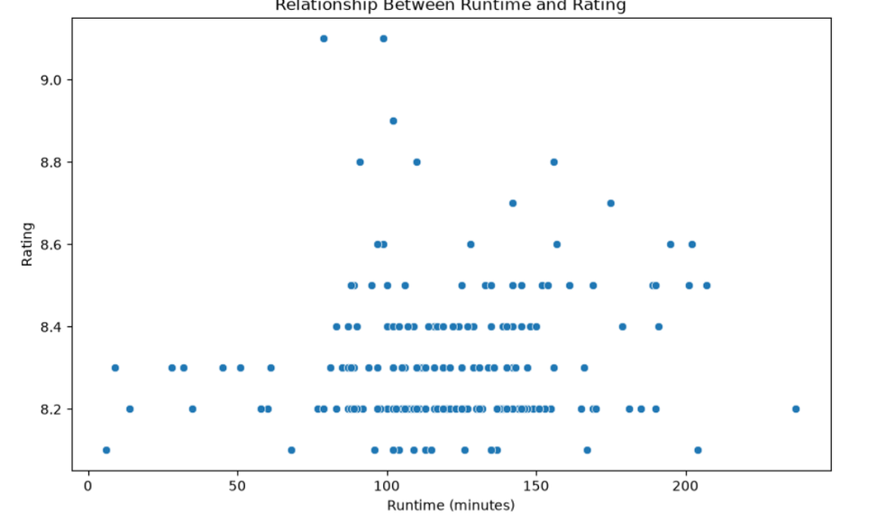
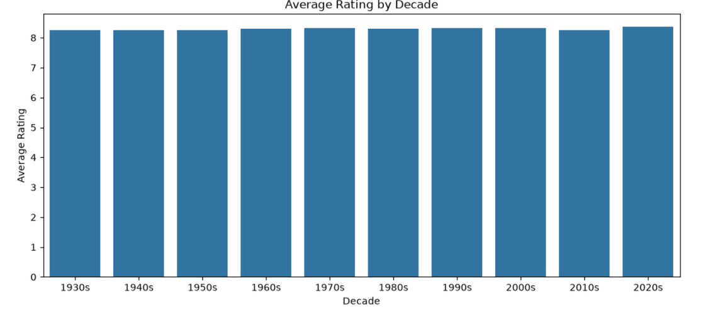
Bivariate Analysis
5. Decade Comparison
  Average ratings are almost identical across decades, all around 8.2 to 8.4.
  The 2020s are slightly the highest (about 8.35) and the 2010s a little lower, but the differences are tiny.
  Release era has almost no effect on rating among top rated movies.
6. Runtime vs Rating
  The points are scattered with no clear straight-line pattern. The correlation is about 0.10, a very weak positive relationship.
  Some of the highest ratings (about 9.1) belong to movies of only about 80 to 100 minutes.
  Movies longer than 150 minutes mostly sit between 8.1 and 8.7, and short films under 70 minutes between 8.1 and 8.3.
  Runtime alone does not decide how well a movie is rated.

Slide 14
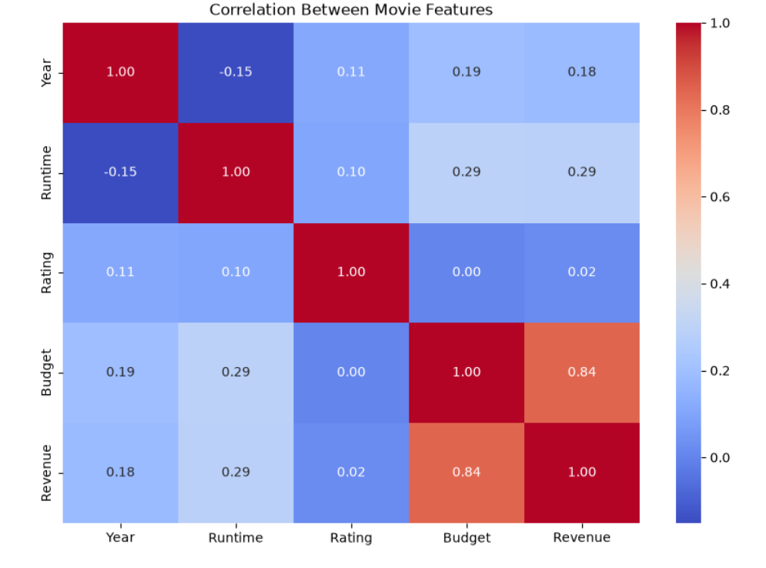
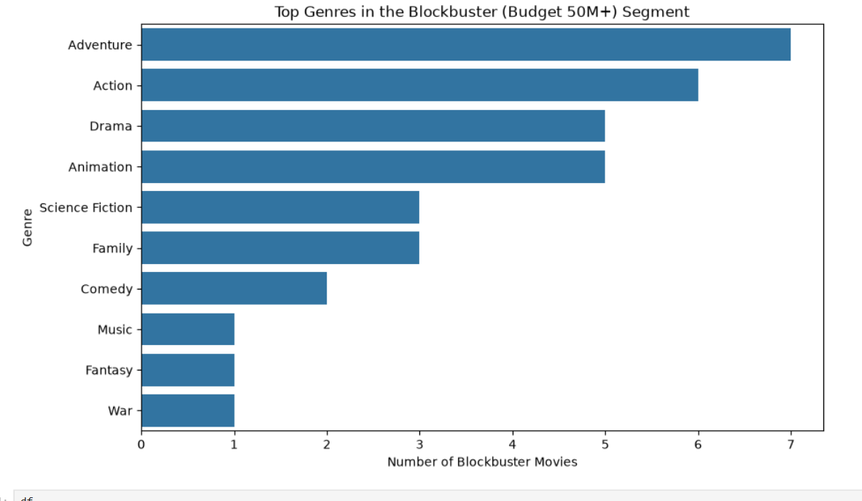
Multivariate Analysis
7. Correlation Heatmap
  Budget and Revenue have a strong positive correlation of 0.84, so movies with bigger budgets tend to earn more.
  Rating is almost unrelated to money: 0.00 with Budget and 0.02 with Revenue. A high budget does not buy a high rating.
  Runtime has a weak positive link with Budget and Revenue (0.29 each), so longer movies tend to cost and earn a little more.
8. Blockbuster Movie Analysis
  Only about 34 movies have a budget of 50 million dollars or more.
  Adventure leads (about 7), followed by Action (about 6), then Drama and Animation (about 5 each).
  Adventure and Action together make up about 38% of this group, so big budgets go mostly into spectacle genres.
  Science Fiction and Family have about 3 each, and Comedy, Music, Fantasy and War very few.

Slide 15

Testing :
1. T-Test Method
I selected the T-test method to determine whether there is a statistically significant difference between the means of two groups.
I used an independent two-sample t-test to compare the means of the selected numerical columns between two groups.
If the p-value is less than 0.05, the difference is considered statistically significant.
Rating: t-statistic = [value], p-value = [value] | Runtime: t-statistic = [value], p-value = [value]
Budget: t-statistic = [value], p-value = [value] | Revenue: t-statistic = [value], p-value = [value] | Profit: t-statistic = [value], p-value = [value]
2. Z-Score Method
  I selected the Z-score method to find values far from the mean, using Z = (x − mean) / std.
  Any value with |Z| > 3 is treated as an outlier.
  Rating: [count] ([%]) | Runtime: [count] ([%]) | Budget: [count] ([%])
  Revenue: [count] ([%]) | Profit: [count] ([%])
  Z-score flagged [fewer/more] outliers than IQR because the right-skewed Budget, Revenue and Profit columns inflate the standard deviation; [neither method / only IQR] found outliers in [column].
Notes:
12

Slide 16
Conclusion
  The project took TMDB’s Top Rated list from raw web pages to business insight.
  Data was scraped with Selenium and BeautifulSoup, cleaned, enriched with new features and validated with checks.
  Charts and business questions show what top rated movies have in common in genre, era, length, language, budget and direction.
  The approach can be extended with the TMDB API, more data, other sources and predictive models to support decisions on which movies to make, buy or promote.

Slide 17
Future Recommendations :
  Use TMDB’s official API for faster and more reliable collection without a browser.
  Collect more fields: vote counts, cast, keywords, production companies, countries.
  Add other sources such as IMDb to compare ratings across platforms.
  Analyse the overview text for common themes and sentiment.
  Build a machine learning model to predict a movie’s rating from genre, runtime, budget and year.
  Create an interactive dashboard in Power BI, Tableau or Streamlit.
  Schedule the scraper and store results in a database to track ranking changes over time.
  Handle missing budget and revenue with better methods or extra data sources.
Notes:
18

Slide 18
Q & A

Slide 19
THANK YOU

